Slide 1
Field Education:
Site Evaluation Report

Slide 2
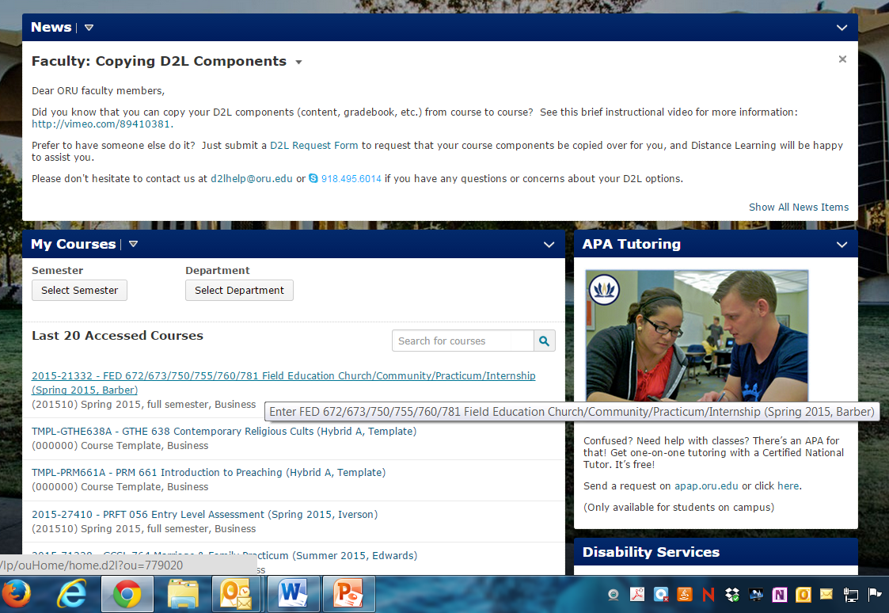
In D2L, select your Field Education Course.

Slide 3
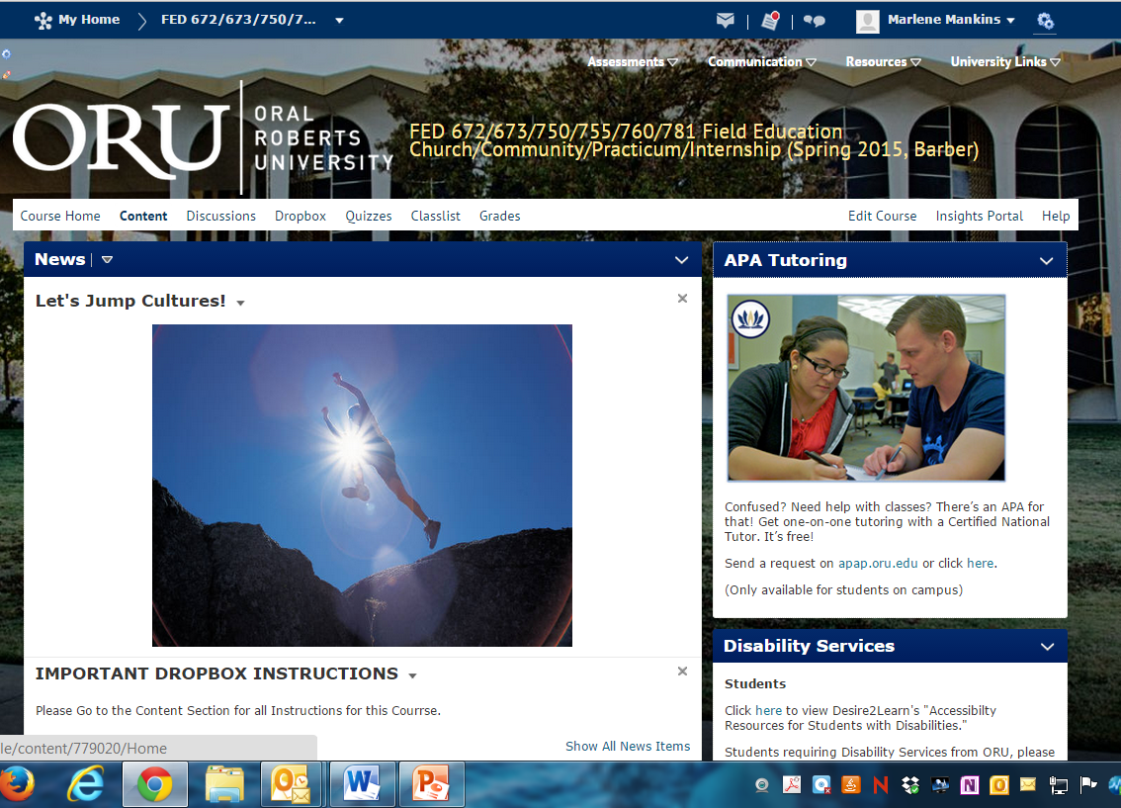
Click on Content

Slide 4
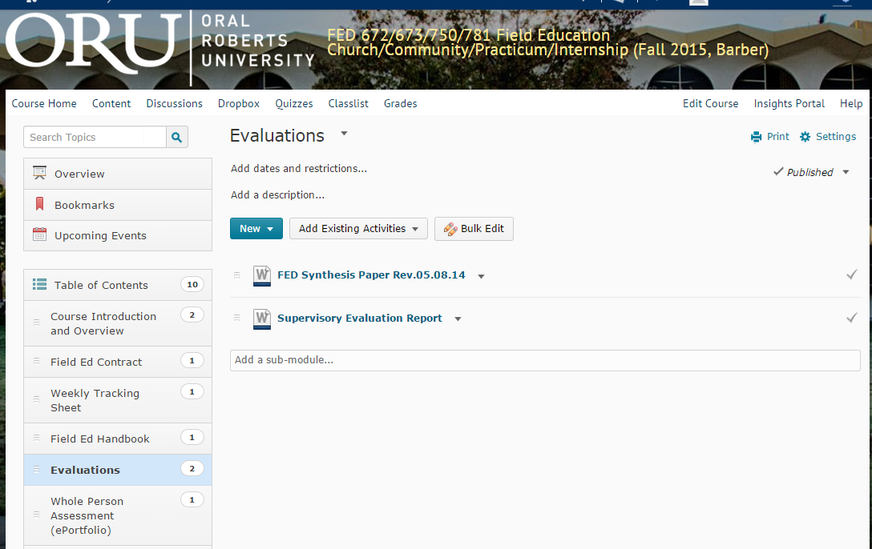
Click on Field Ed Contract on left menu.
Then click on the FED Learning Contract.

Slide 5
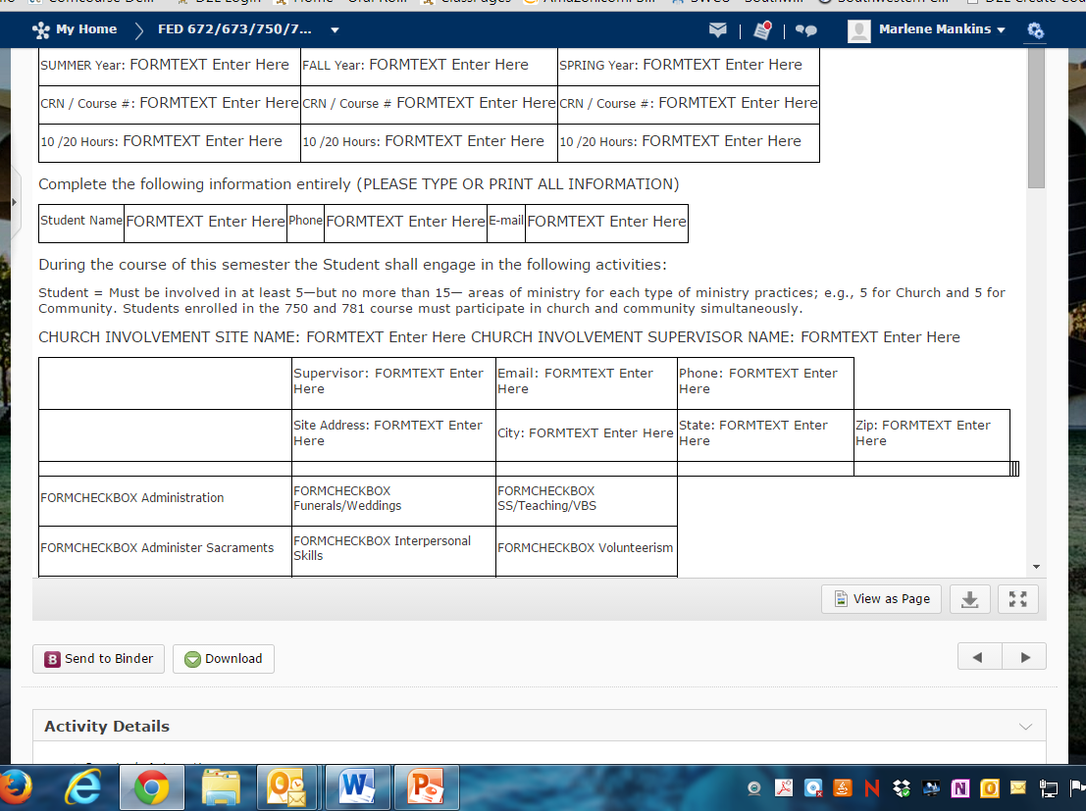
Click on Download and save the Site Evaluation Report
to your computer or flashdrive.

Slide 6
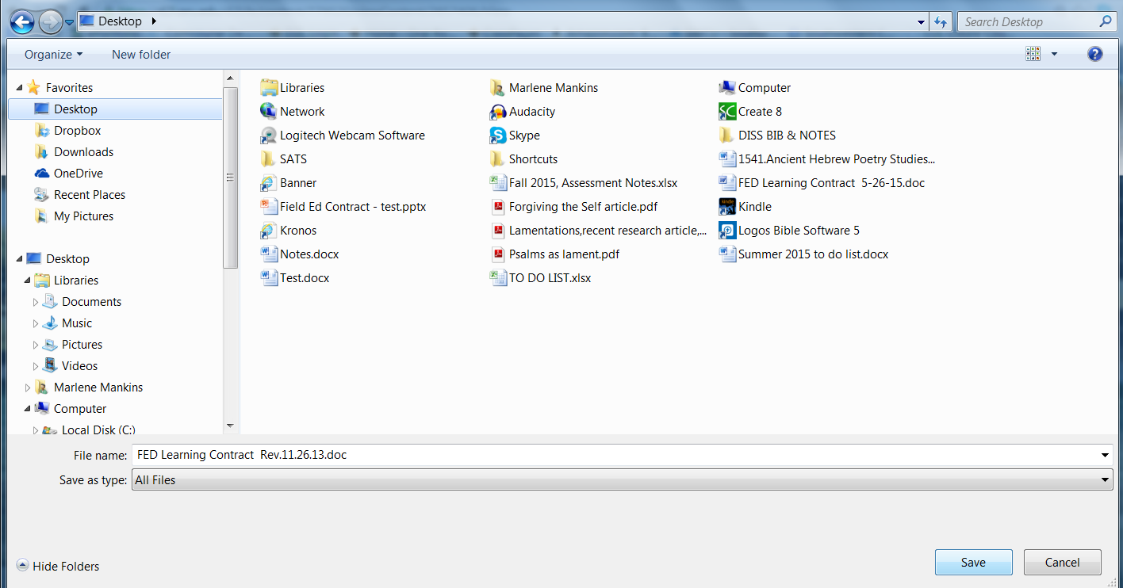
Save document to your computer or flashdrive.

Slide 7
Fill out all required fields in form.

Slide 8
The supervisor is to write a letter grade in the space before
each ministry item below that was selected in the student’s
Learning Contract.

Slide 9
The site supervisor will also indicate his or her letter grade evaluation
of the questions below:

Slide 10
The site supervisor will sign the completed form.
The student will scan the completed and signed form
and upload it to the appropriate D2L dropbox

Slide 11
To submit the completed and signed evaluation report:
Click on Dropbox.
Then click on Evaluation(s).

Slide 12
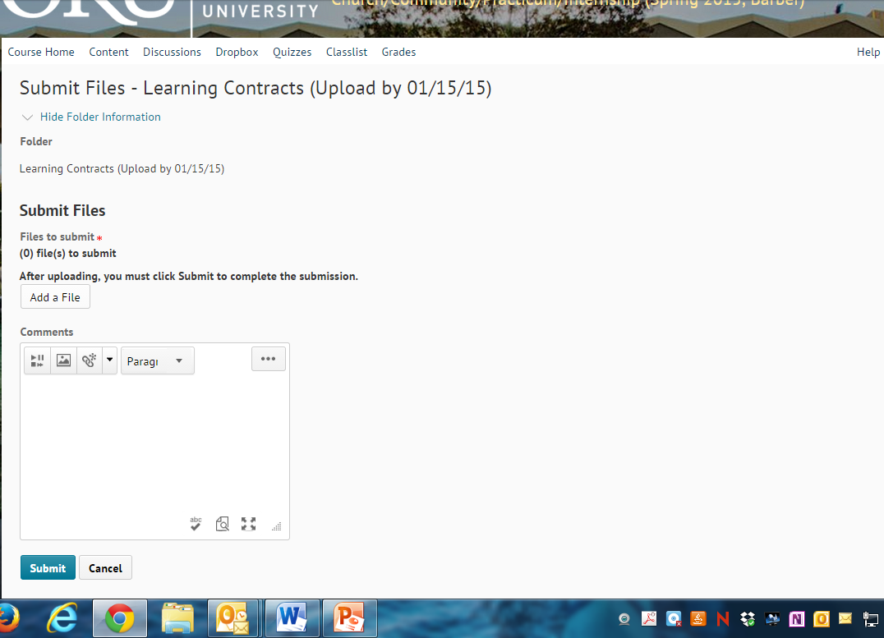
Follow screen prompts to upload your document.

Slide 13
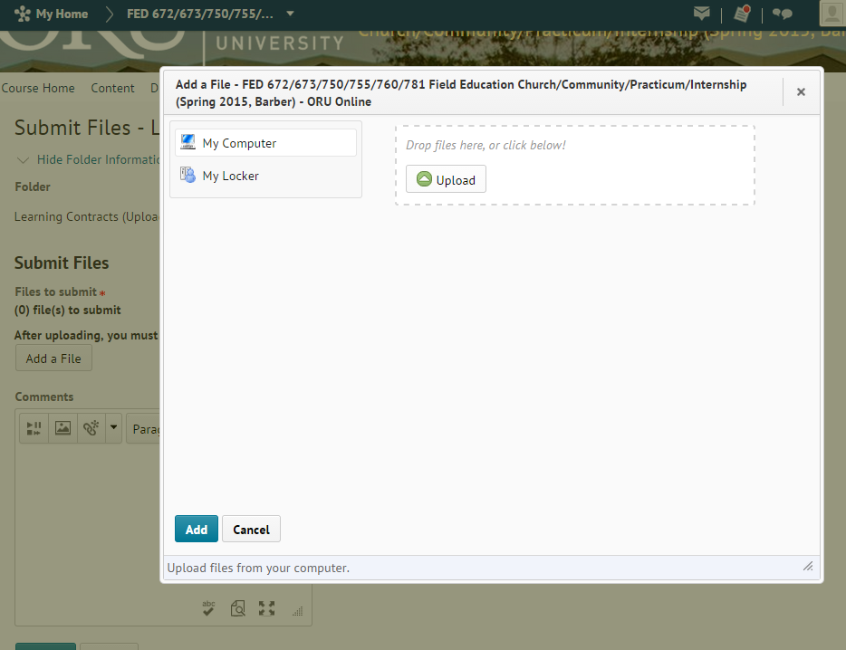
Follow screen prompts to upload your document.

Slide 14
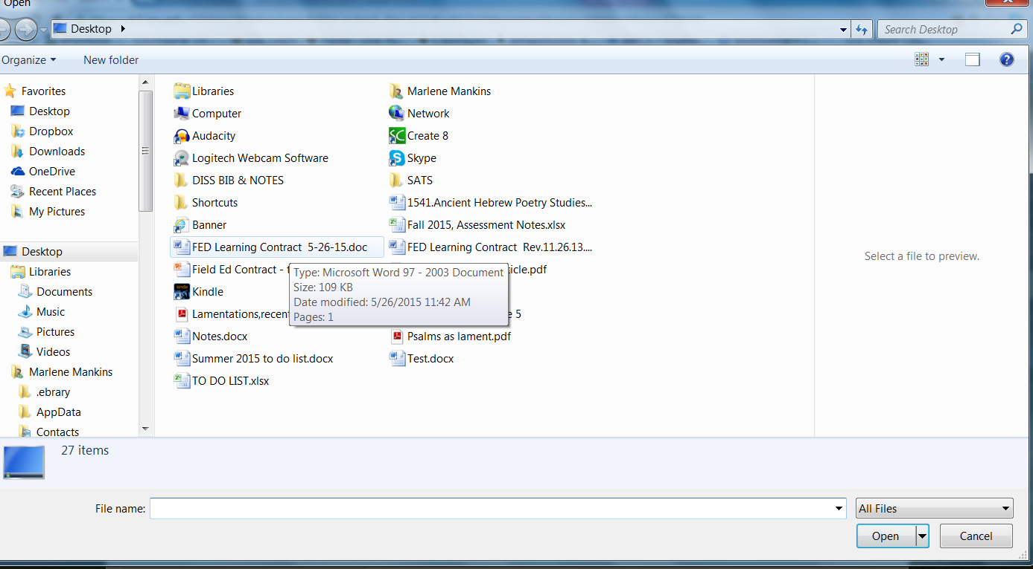
Select file from your computer or flashdrive.
Click Open.

Slide 15
Follow screen prompts to complete your submission.

Slide 16
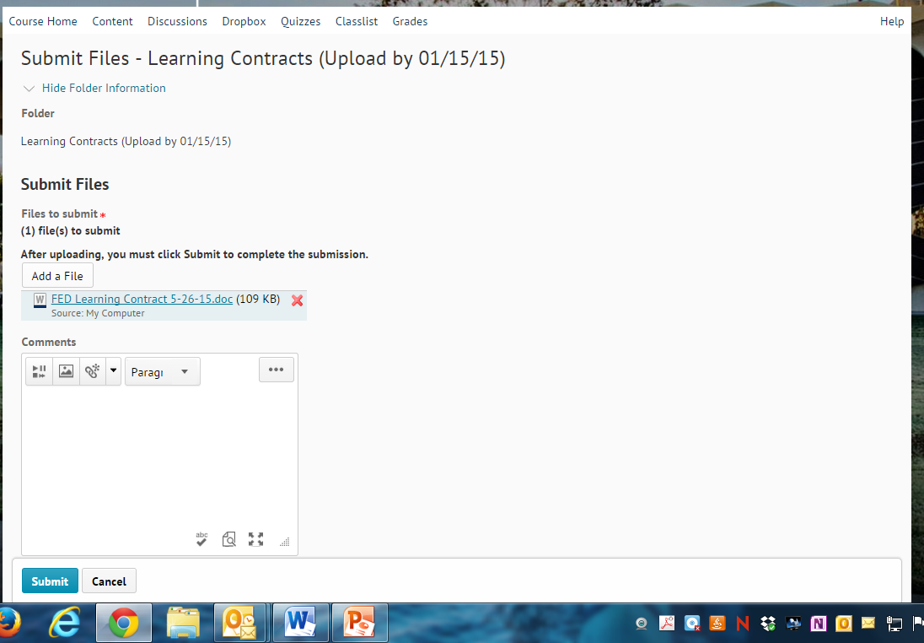
Follow screen prompts to complete your submission.

Slide 17
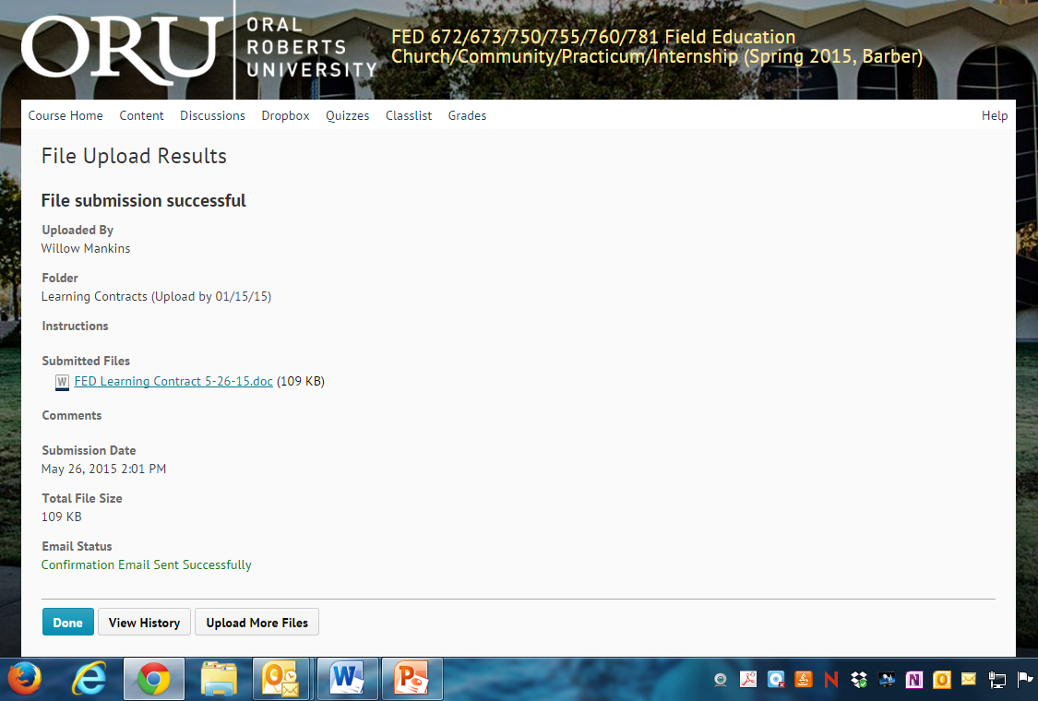
Follow screen prompts to complete your submission.

Slide 18
You have successfully submitted your
Site Supervisor Evaluation Report!

