Slide 1
Field Education:
Learning Contract

Slide 2
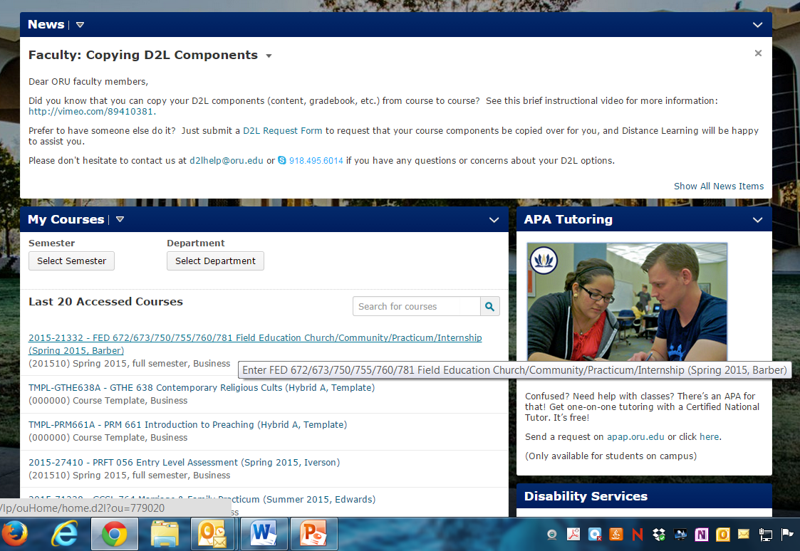
In D2L, select your Field Education Course.

Slide 3
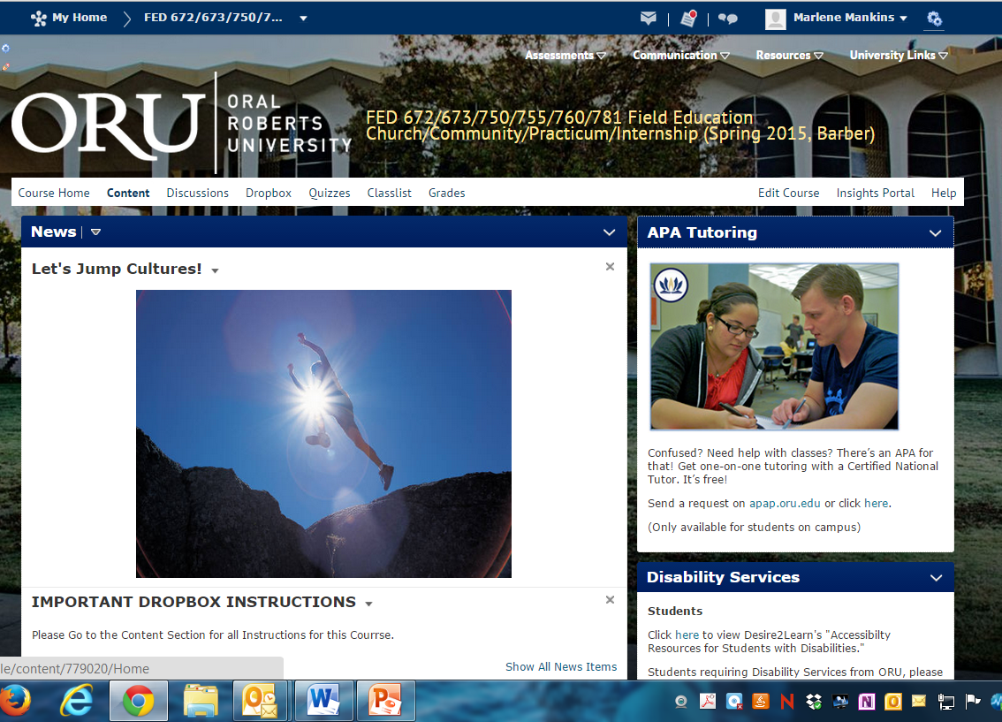
Click on Content

Slide 4
Click on Field Ed Contract on left menu.
Then click on the FED Learning Contract.

Slide 5
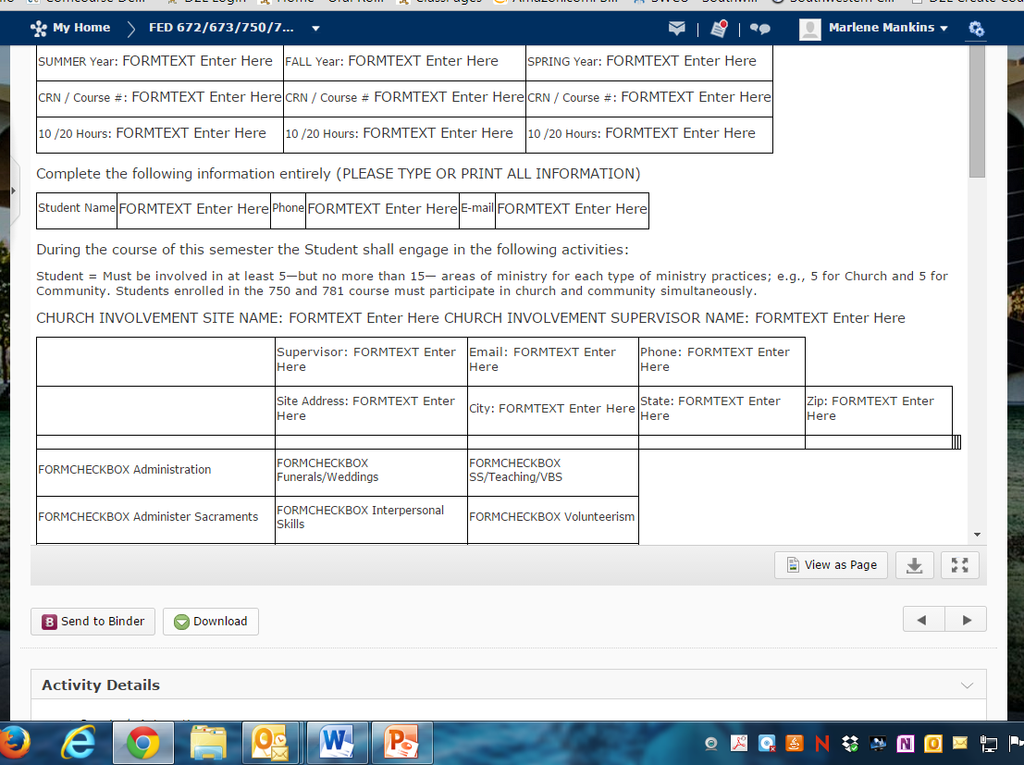
Click on Download and save the Learning Contract to your computer or flashdrive.

Slide 6
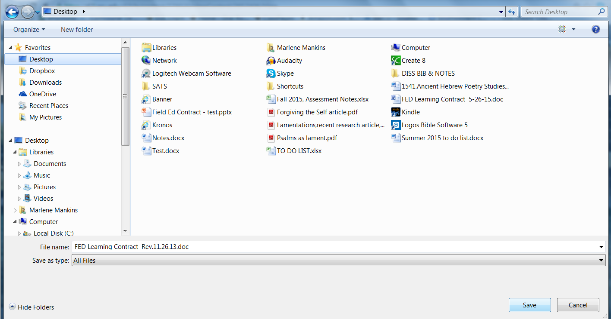
Save Learning Contract to your computer or flashdrive.

Slide 7
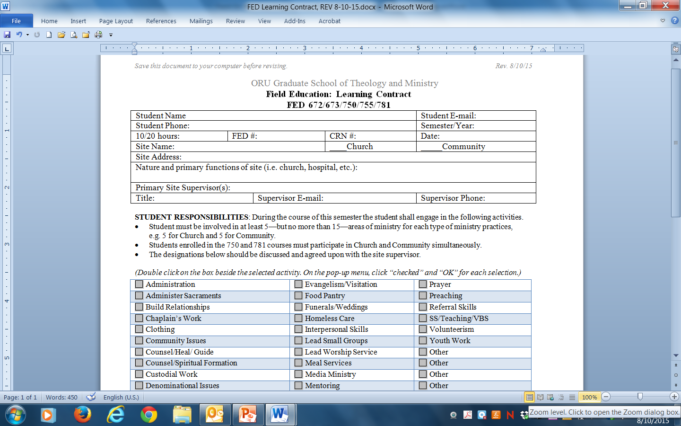
Fill out all required fields in form.

Slide 8
Once you have discussed and agreed upon ministry designations with your site supervisor, double click on the box of the activity(ies) you want to select.

Slide 9
On the pop-up text box, select “Checked” and then OK.

Slide 10
You will now see an X in the selected box(es).
Save your changes.

Slide 11
Both the student and site supervisor need to sign the form
after it has been filled out.
Make a copy so both you and your supervisor can keep one.
Then upload the signed and completed form to D2L.

Slide 12
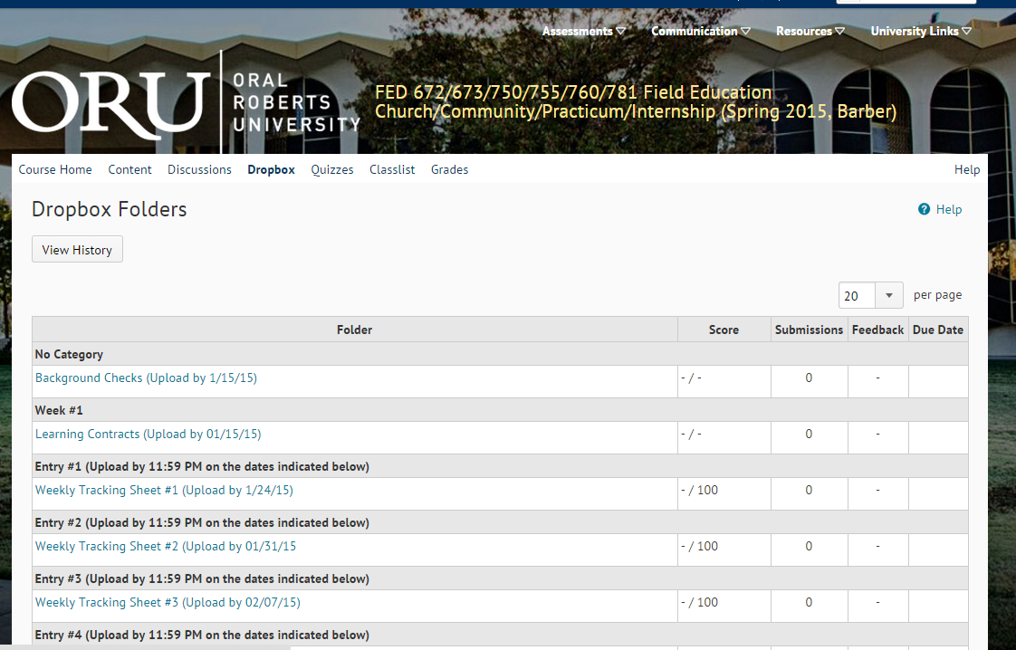
To submit the completed and signed Learning Contract:
Click on Dropbox.
Click on Learning Contract.

Slide 13
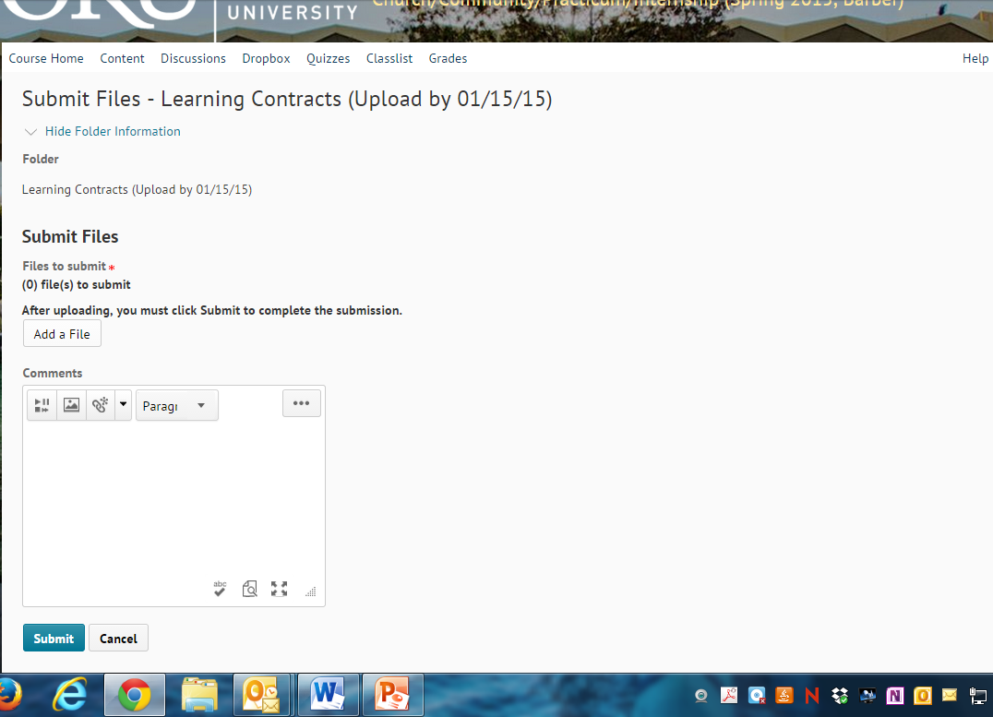
Follow screen prompts to upload your document.

Slide 14
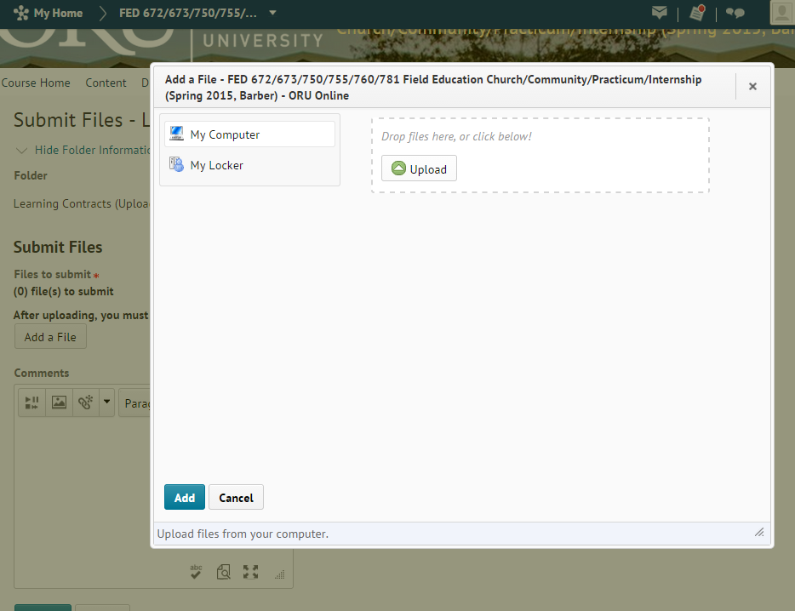
Follow screen prompts to upload your document.

Slide 15
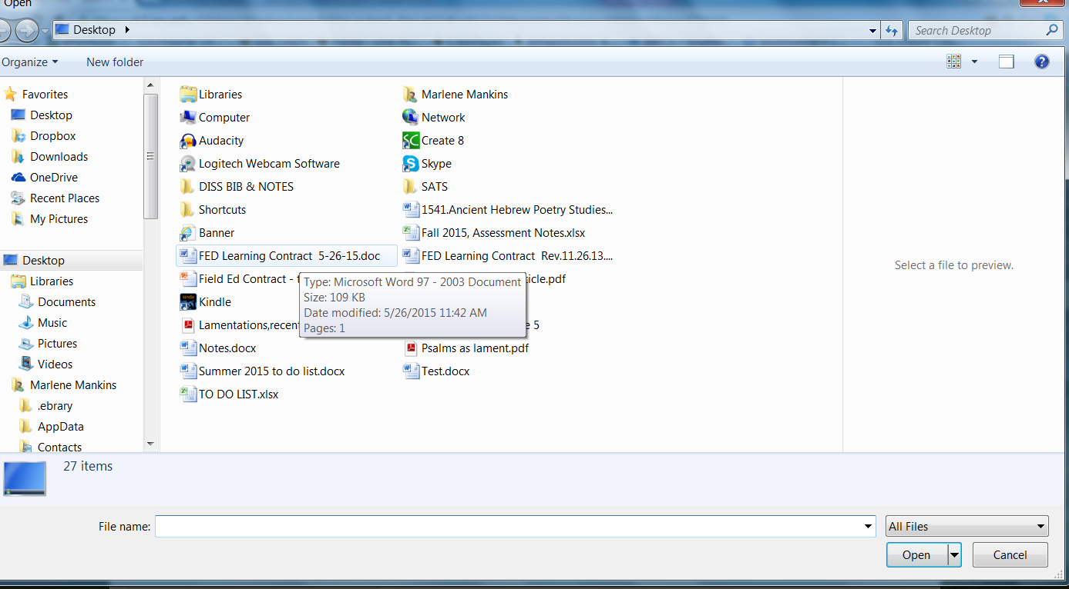
Select file from your computer or flashdrive.
Click Open.

Slide 16
Follow screen prompts to complete your submission.

Slide 17
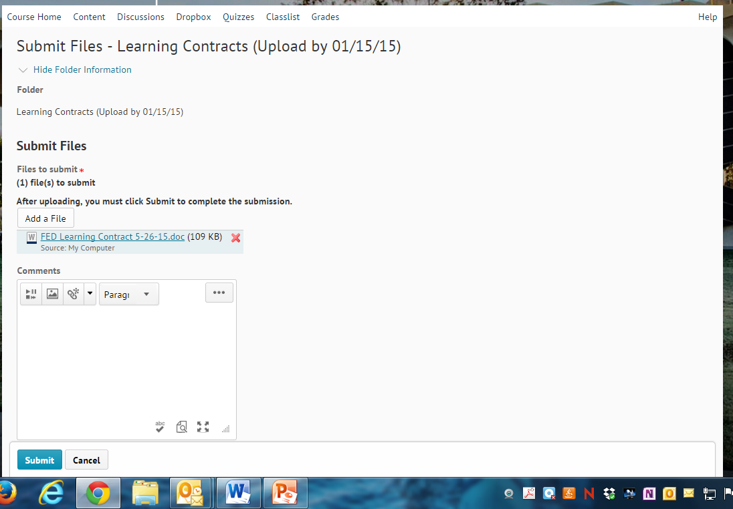
Follow screen prompts to complete your submission.

Slide 18
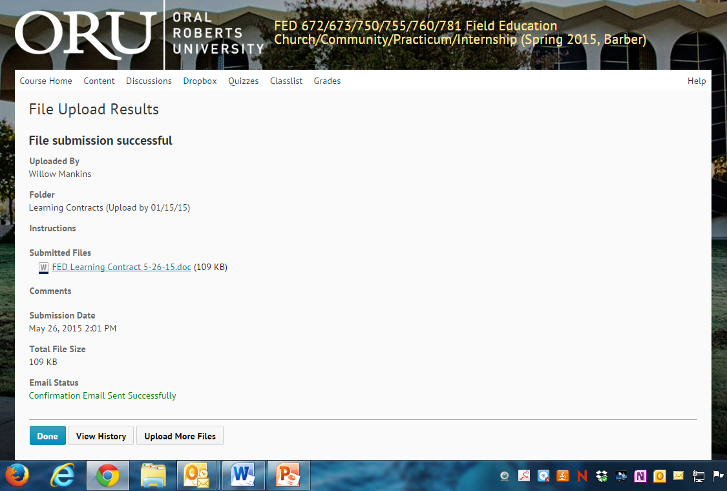
Follow screen prompts to complete your submission.

Slide 19
You have successfully submitted your
Learning Contract!

